Slide 1

Crisis Leadership Overview
Stability, Direction, and Human-Centered Decision-Making Under Pressure
What Is Crisis Leadership?
Leadership during disruption is different from leadership in stability
Crisis compresses time and raises emotional intensity
Decisions must balance authority and empathy
The leader becomes the stabilizing reference point

Slide 2
CLASS AGENDA
CLASS OBJECTIVES
Define crisis leadership
Shifts from normal leadership
Authority vs calm presence
Decision clarity under pressure
Foundation for advanced topics
Understand the unique context of crisis leadership
Recognize emotional and operational pressures
Learn why clarity matters more than complexity
Link leadership to trust
Set baseline for psychology

Slide 3

How Crisis Changes the Role of a Leader
Leadership shifts from optimizations to stabilization
People look for certainty more than detail
The leader becomes a signal of safety
Clarity beats technical accuracy early in a crisis

Slide 4

Authority and Decision Rights
Crisis requires shorter decision cycles
Delays create risk and instability
Escalation must be fast and controlled
Decision rights must be understood before activation

Slide 5

Emotional Regulation as Leadership Output
People copy the leader's emotional tone
Calm is interpreted as control
Panic is interpreted as incompetence
Regulation precedes clarity

Slide 6
Where Leadership Commonly Breaks Down
Delay in declaring the situation
Emotional volatility
Indecisive posture
Conflicting direction
Mixed signals to stakeholders
Inconsistent visibility
Over-focus on technical detail
Unclear roles or authority
Avoidance of responsibility
Fear of accountability

Slide 7

Crisis Leadership as a Stabilizing Function
Leadership reduces uncertainty
Stability generates followership
Communicated calm lowers panic
Confidence enables execution

Slide 8
What People Need From a Crisis Leader
Clarity
Confidence
Direction
Defined next steps
Emotional safety
Protection from noise
Visible presence
Trustworthy tone
Consistency
Predictable messaging

Slide 9
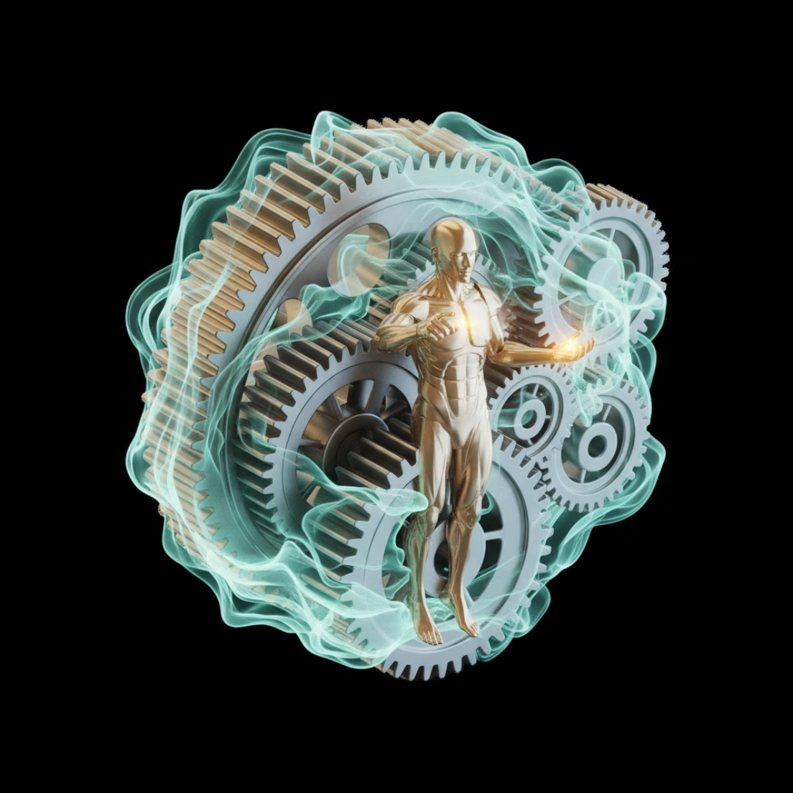
The Hybrid Model of Crisis Leadership
Combines authority with calm presence
Uses structure without rigidity
Guides rather than reacts
Provides confidence before solutions

Slide 10

Crisis Leadership Posture
Upright visibility
Stable tone
Controlled pacing
Calm delivery
Short instructions
Decisive close-out
Simple framing
No panic cues
Low emotion language
Reassuring cadence

Slide 11

Summary & Takeaways
Crisis leadership is a distinct discipline
People follow emotional signals before direction
Stability is the first output of leadership
Clarity reduces fear and hesitation
Authority without calm loses trust
Calm without direction loses control
True crisis leadership is hybrid: structure + presence

Slide 12
BREAK TIME
Be back in 15 mins.
Notes:
https://www.ncsc.gov.uk/static-assets/documents/PwnedPasswordsTop100k.txt

Slide 13

Psychology of Crisis
Stress, uncertainty, and time compression
How the mind reacts under pressure and what leaders must stabilize first.
What happens in our minds during a Crisis
How the Psychological Response is directly related to resilience
How decision making is affected
Leaderships role during the Crisis
Your role during the Crisis
The impact of cognitive biases on decision-making under pressure
The role of emotional regulation in maintaining composure
Importance of fostering psychological safety in teams during crisis

Slide 14
CLASS AGENDA
CLASS OBJECTIVES
How crisis affects the human mind
Stress and physiological response
Uncertainty and psychological distortion
Time compression and decision impact
Implications for crisis leadership
Understand why reactions intensify under crisis
Recognize what leaders must stabilize first
See how cognition changes under pressure
Link psychology to behavior and performance
Prepare for leadership countermeasures

Slide 15

What "Crisis Psychology" Means
Crisis shifts people from reasoning to survival mode
The brain looks for safety signals before information
Emotion becomes the first filter for perception
Leaders must stabilize minds before processes
Physiological responses like 'fight, flight, or freeze' are amplified, prioritizing immediate threat response over complex thought.
Cognitive biases increase, leading to distorted perceptions and difficulty evaluating risks rationally.
Clear, concise communication and visible, calm leadership are crucial for re-establishing a sense of safety and control.

Slide 16
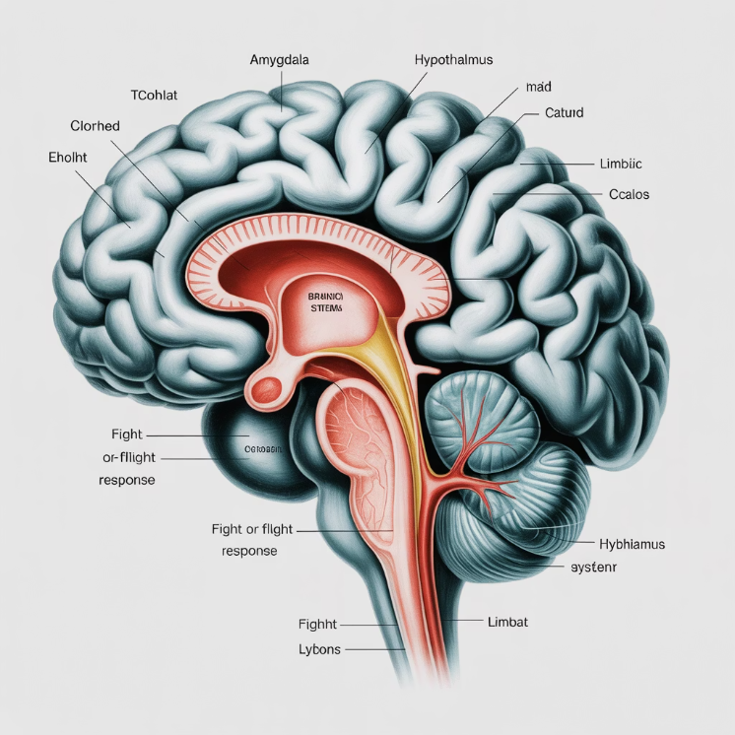
Threat Response: The Primitive Brain First
Under threat, the brain prioritizes survival over logic
Fight–flight–freeze emerges before analysis
Emotional systems override executive thinking
The prefrontal cortex, responsible for planning and logic, is suppressed.
This ancient response is an evolutionary safeguard for rapid action against danger.
Re-establishing a sense of control helps reactivate rational thought processes.
Calm must be reintroduced before clarity

Slide 17

Physiological Stress Reactions
Adrenaline compresses reaction speed
Breathing becomes shallow and unstable
Cognitive range narrows
Discomfort is misread as danger
Increased muscle tension impairs fine motor control
Peripheral vision diminishes, leading to "tunnel vision"
Digestion slows as blood is redirected, leading to physical discomfort

Slide 18
Stress Effects - Physical
Hyper-vigilance
Overreaction
Tunnel vision
Emotional spikes
Stress Effects - Behavioral
Reduced patience
Defensive posture
Short attention span
Escalated tone
Physical tension
Lowered reasoning range

Slide 19
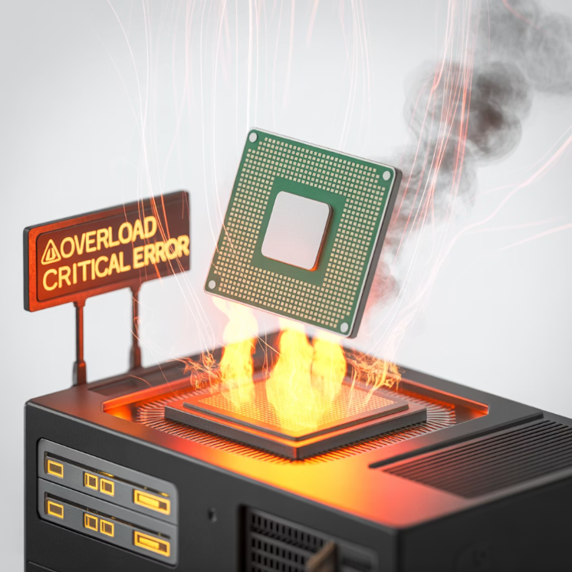
Cognitive Overload Under Crisis
The brain drops nonessential thinking
Processing speed declines
People revert to habit, not planning
Complexity becomes overwhelming
Decision-making becomes less rational
Situational awareness decreases significantly
Emotional responses amplify, impacting judgment

Slide 20

What Uncertainty Does to the Brain
Uncertainty removes psychological footing
People search for control signals
Doubt feels like danger
Silence increases perceived threat
It triggers a heightened state of vigilance and anxiety
Cognitive resources are diverted to monitoring threats, reducing capacity for complex tasks
The need for closure increases, sometimes leading to premature decisions

Slide 21

Perceptual Distortion
Threats feel larger than they are
People assume worst-case outcomes
Neutral cues feel unsafe
Risk becomes exaggerated
Cognitive biases amplify negative interpretations
Emotional states influence how information is processed
Focus narrows to potential dangers, ignoring positive aspects

Slide 22
Uncertainty Effects - Mental
Mental fog
Rumination
Hesitation
Distrust
Anxiety loops
Uncertainty Effects - Social
Story-making
Worst-case bias
Emotional projection
Compromised judgment
Social withdrawal

Slide 23

Time Compression Defined
Time "feels shorter" than it is
Urgency accelerates emotional impact
Action feels mandatory even without clarity
Delay feels like failure
Heightened stress response: The constant feeling of urgency triggers a sustained fight-or-flight response.
Narrowed focus: Prioritizing immediate tasks can lead to overlooking long-term strategy or important details.
Impaired decision-making: Rushed choices are common as the mind seeks quick resolutions, often at the expense of thorough analysis.

Slide 24

Decision Pressure Under Time Compression
Leaders feel forced to act instantly
Mental shortcuts replace reasoning
Strategic thinking collapses into reaction
Fatigue accelerates poor judgment
Pressure impairs information processing and risk assessment
Confirmation bias strengthens, seeking quick validation for rapid choices
Focus shifts to immediate fixes, overlooking long-term consequences

Slide 25

Behavioral Regression Patterns
People revert to instinctive habits
Communication becomes clipped
Listening decreases
Emotional tone hardens
Increased reliance on heuristics and stereotypes
Reduced empathy for others' perspectives
Tendency to externalize blame

Slide 26
Time Compression Effects - Decision Quality
Time Compression Effects - Cognitive
Speed over accuracy
Loss of nuance
Impulse decision-making
Reduced empathy
Verbal intensity
Premature conclusions
Restless posture
Abrupt escalation
Risk misread
Judgment collapse

Slide 27

Impact on Leaders
Leaders feel visibility pressure
Confidence becomes harder to project
Emotional leakage is amplified
Tone becomes signal, not words
Reduced capacity for nuanced problem-solving
Increased reliance on intuition over data
Diminished patience for dissent or complex discussions

Slide 28

Impact on Teams
Teams look for emotional anchoring
Silence is interpreted as loss of control
Fear accelerates rumor spread
People rely on leader posture
Uncertainty amplifies anxiety and reduces productivity
Lack of transparent communication breeds distrust
A leader's calm demeanor fosters a sense of security and stability

Slide 29

Emotional Contagion
Nervous leaders spread nervousness
Calm leaders spread stability
Emotion transfers faster than logic
Tone reaches people before message
Non-verbal cues (facial expressions, body language) are potent carriers of emotion.
The unconscious mimicking of others' expressions and postures contributes to emotional transfer.
Collective emotional states can quickly form, influencing team performance and morale.

Slide 30
Combined Impact - Individual
Combined Impact - Organizational
Lower reasoning capacity
Spike in emotional load
Greater misreads
Higher error likelihood
Unstable attention
Shorter tolerance window
Threat exaggeration
Impulsive behavior
Trust fluctuation
Reduced resilience

Slide 31

Stabilization Through Leadership Presence
First task is restoring psychological footing
Presence > messaging
Emotional containment precedes guidance
Calm resets reasoning
Leader's composure fosters psychological safety
Empathy and validation reduce emotional reactivity
Consistent reassurance builds collective confidence

Slide 32

Early Psychological Countermeasures
Slow the tempo
Reduce ambiguity
Shorten communication loops
Anchor attention to now
Use direct, simple language
Prioritize immediate, actionable steps
Reiterate purpose and shared goals

Slide 33

Summary & Takeaways
Crisis psychology reshapes how people think and behave
Stress shrinks cognitive range
Uncertainty amplifies perceived threat
Time compression distorts urgency
Emotional contagion spreads faster than logic
Stability must be restored before direction
Leadership is psychological before operational
Acknowledging fear validates experience, reducing isolation
Empowering action combats helplessness and restores agency
Structured hope provides a path forward beyond immediate crisis

Slide 34
BREAK TIME
Be back in 15 mins.
Notes:
https://www.ncsc.gov.uk/static-assets/documents/PwnedPasswordsTop100k.txt

Slide 35

Traits of Effective Crisis Leaders
Clarity, Calmness, Decisiveness, and Adaptability in high-pressure conditions
The Role of Traits in Crisis Leadership
Capabilities matter less if leadership posture collapses, undermining trust and efficacy.
Traits shape how people interpret leader actions, influencing team morale and response.
Behavior becomes the message during crisis, fostering confidence or anxiety.
These traits determine psychological safety, crucial for open communication and problem-solving.

Slide 36
CLASS AGENDA
CLASS OBJECTIVES
Why traits drive response outcomes
Clarity under uncertainty
Calmness under stress
Decisiveness under time compression
Adaptability in changing conditions
Recognize trait-based leadership effects
See how traits reduce chaos
Understand stabilizing posture signals
Link traits to psychological influence
Prepare for real crisis behaviors

Slide 37
Why Traits Matter More Than Plans
People follow emotional tone, even before clear direction.
Traits firmly anchor their perception of effective control.
Psychological safety always precedes successful and rapid execution.
Competence is truly judged through behavior during crisis.
Leaders' authenticity builds crucial trust and commitment.
Consistency in values ensures organizational stability.

Slide 38

Clarity
Reduces mental fog, enhances clear decision-making
Shortens uncertainty loops, fostering swift action
Converts complexity into direction, simplifying intricate problems
Helps others reorient under pressure, guiding effective responses
Promotes transparent communication within the team
Builds trust and confidence among stakeholders

Slide 39
CLARITY REFLECTION
Communication Elements
Delivery Style
Simple statements
Direct framing
Defined next steps
No hedging language
No excess detail
Visible priorities
Pacing controlled
Fewer choices
Signal over noise
Confidence in delivery

Slide 40

Calmness
Emotional containment becomes stability, fostering inner peace.
Tone regulates group physiology, promoting collective composure.
Presence lowers panic threshold, creating a safe space.
Calm signals control before instruction, building trust effectively.
Clear thinking emerges from settled minds.
Reduces reactivity, enhances thoughtful responses.

Slide 41
CALMNESS REFLECTION
Physical Presence
Emotional Regulation
Measured voice
No panic cues
Steady tempo
Neutral language
Lower volume
Slowing urgency
Grounded posture
Emotional consistency
Predictable cadence
Non-reactive stance

Slide 42

Decisiveness
Prevents uncertainty from spiraling, ensuring clear path ahead.
Protects momentum, driving projects continually forward.
Demonstrates ownership, fostering strong accountability always.
Keeps response directional, guiding decisions effectively onward.
Instills confidence within the entire team.
Minimizes wasted time and valuable resources.

Slide 43
DECISIVENESS REFLECTION
Decision Process
Authority Display
Fast activation ensures quick initial response
Visible authority builds immediate trust quickly
No ambiguity clarifies intent immediately
Confident framing establishes clear direction strongly
Defined outcomes guide every decision swiftly
No waiting posture indicates readiness always
Short commands boost team responsiveness greatly
Minimal debate streamlines all decision-making
Closed decisions prevent any second-guessing
Momentum maintained drives continuous progress forward
Proactive engagement reduces potential delays.
Clear communication drives efficient execution.
Decisive actions inspire team confidence.
Strong leadership ensures consistent progress.

Slide 44
Adaptability
Crisis conditions can evolve rapidly with absolutely no prior warning.
Leaders must shift their posture strategically without losing vital stability.
Adaptability consistently maintains leadership credibility, even during challenges.
Flexibility prevents escalation effectively from freezing important organizational progress.
Embracing change allows organizations to navigate unforeseen obstacles successfully.
Proactive adjustments minimize potential risks and foster sustained growth.

Slide 45
SUMMARY & TAKEAWAYS
Traits determine perceived leadership strength in times of crisis.
Clarity reduces uncertainty and fosters confident decision-making.
Calmness prevents escalation and maintains rational thought.
Decisiveness restores direction and inspires renewed progress.
Adaptability sustains momentum through evolving complex challenges.
Behavior shapes trust more than messaging during challenging unpredictable situations.
These traits are stabilization tools, not personality preferences for effective leadership.
Empathy builds connection and understanding during difficult times.
Resilience enables recovery and continued forward movement.

Slide 46
BREAK TIME
Be back in 15 mins.
Notes:
https://www.ncsc.gov.uk/static-assets/documents/PwnedPasswordsTop100k.txt

Slide 47
Lab Time
1 Hour
Notes:
https://www.ncsc.gov.uk/static-assets/documents/PwnedPasswordsTop100k.txt

Slide 48


Crisis Leadership: Recap & Review
Psychology, Traits, and Stabilization Through Presence
Crisis Leadership Overview
Crisis shifts leadership from optimization to stabilization
Presence and posture become signals of control
Clarity matters more than technical precision
Calm is interpreted as capability
The leader becomes the emotional "anchor" under stress
Governance Anchor: "Crisis leadership protects psychological stability so governance can operate effectively."

Slide 49

Psychology of Crisis
Crisis pushes people into survival mode
Emotion comes before logic when threat is perceived
Stress and uncertainty shrink cognitive range
Time compression increases reactive decisions
Stabilization of the mind comes before stabilization of the system
Governance Anchor: "Before strategy works, the mind must be stabilized."

Slide 50
Traits of Effective Crisis Leaders
Clarity reduces overwhelm and creates direction
Calm preserves psychological safety
Decisiveness prevents drift and hesitation
Adaptability sustains control as conditions evolve
Traits are leadership tools, not personality preferences
Governance Anchor: "Traits hold confidence in place when plans have not yet taken hold."

Slide 51

Crisis Leadership Behaviors in Practice
Posture and tone shape collective emotion
Communication must be direct and stabilizing
Authority must be visible and firm
Emotional containment precedes guidance
Presence is interpreted as competence
Governance Anchor: "Leadership becomes operational when emotional stability is restored."

Slide 52
Lab Application: Decision-Making Under Pressure
The lab simulates time-compressed decision cycles
Stress testing posture precedes testing plans
Leaders must stabilize tone before directing action
Execution confidence is a leadership output
Behavior under pressure becomes evidence of maturity
Governance Anchor: "Crisis leadership is proven through live posture, not documentation."

Slide 53
Kahootz & Quiz Time
Notes:
https://www.ncsc.gov.uk/static-assets/documents/PwnedPasswordsTop100k.txt

